Slide 1
Prediction of Default of Credit Card Clients
Project Presentation of ISE 444
Bolun Xu & Weiming Lei

Slide 2

Main Purpose
Using financial information to predict whether a client would default in the future
Analysing results and comparing accuracy of 4 different methods
?
?
?

Slide 3
Data
30,000 instances (clients): 70% for training, 30% for testing
24 attributes: Including clients’ basic information (age, education ,marriage), history of past payment, amount of bill statement and amount of previous payment
Using a binary variable, default payment (Yes = 1, No = 0), as the response variable

Slide 4
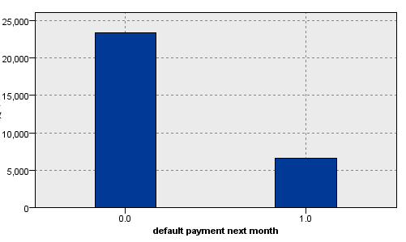
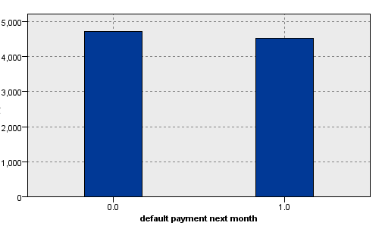
Data Processing
Delete records with missing value(Since we have enough records)
Delete obvious irrelavent attributes
Balance training data
Unbalanced data may cause overfitting.

Slide 5
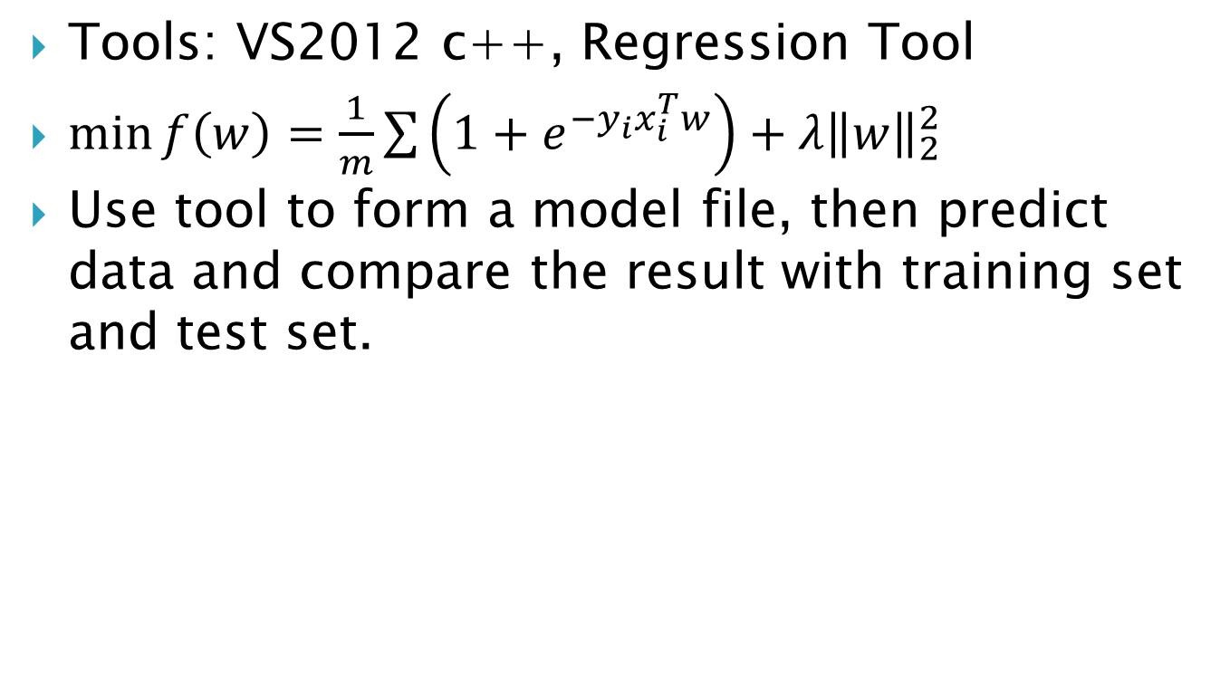
1. Logistic Regression
Tools: VS2012 c++, Regression Tool
$\min{f\left(w\right)}=\frac{1}{m}\sum{\left(1+e^{−y_{i}x_{i}^{T}w}\right)+λ{\left\|w\right\|}_{2}^{2}}$
Use tool to form a model file, then predict data and compare the result with training set and test set.
 | Training | Testing
Accuracy | 64.06 | 63.67

Slide 6

2. SVM
Tools: VS2012 C++, LibSVM3.19
Linear
Polynomial kernel: D=2, 3
RBF: $γ$=0.01, 0.05, 0.10, 0.5, 1, 10.

Slide 7

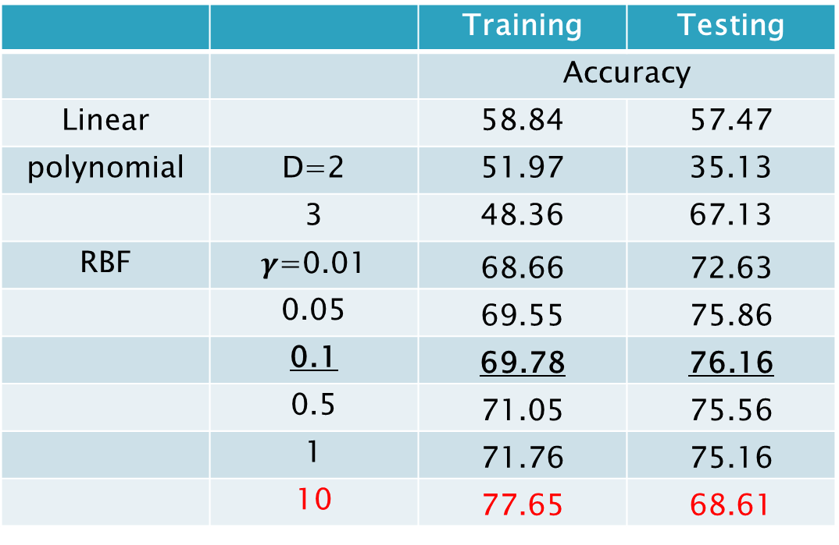
2. SVM Result
 |  | Training | Testing
 |  | Accuracy
Linear |  | 58.84 | 57.47
polynomial | D=2 | 51.97 | 35.13
 | 3 | 48.36 | 67.13
RBF | $γ$=0.01 | 68.66 | 72.63
 | 0.05 | 69.55 | 75.86
 | 0.1 | 69.78 | 76.16
 | 0.5 | 71.05 | 75.56
 | 1 | 71.76 | 75.16
 | 10 | 77.65 | 68.61
Best!
Observed overfitting when$γ$ increase to large enough.

Slide 8
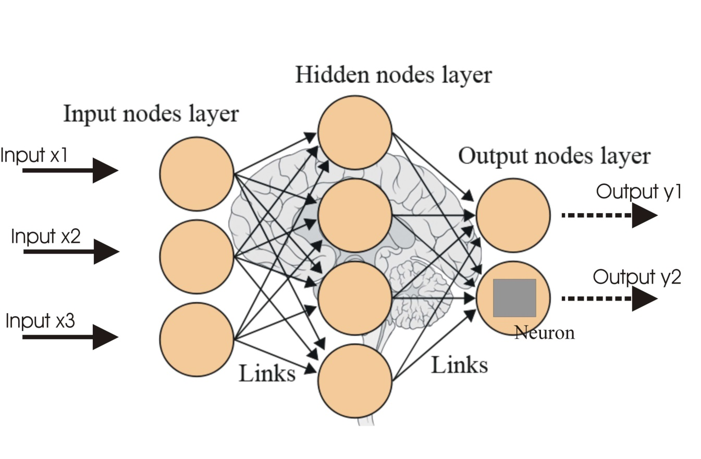
3. Artificial Neural Network
Tool: IBM SPSS/ SAS EM
Paper Read

Slide 9
3. Neural Network
Result
Hidden nodes | Training | Testing | Testing
 | Accuracy |  | Gain at 20%
1 | 68.73 | 77.9 | 47.99
2 | 69.1 | 78.03 | 47.75
3 | 68.91 | 78.45 | 48.27
5 | 70.03 | 77.31 | 48.46
7 | 69.79 | 76.83 | 48.89
9 | 69.64 | 76.06 | 48.79
Best!

Slide 10
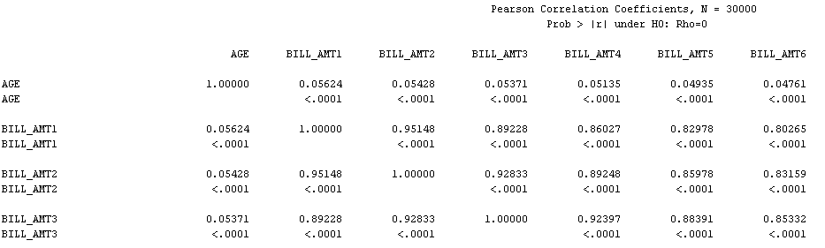
3. Neural Network
Simplify the data. Discard unimportant and redundant attributes.
Pearson correlation coefficients Matrices
C5.0 Decision tree to decide Importance
We do not delete records. We only shatter features.

Slide 11
3. Neural Network
Result
Hidden nodes | Training | Testing | Testing
 | Accuracy |  | Gain at 20%
1 | 71.85 | 80.32 | 48.03
2 | 69.52 | 76.99 | 48.84
3 | 69.83 | 77.36 | 48.93
5 | 69.74 | 76.66 | 49.31
7 | 68.98 | 75.27 | 48.65
9 | 69.32 | 75.88 | 48.27
Best!
80.32% is quite close to the best result in papers- 84%

Slide 12
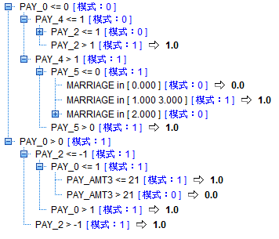
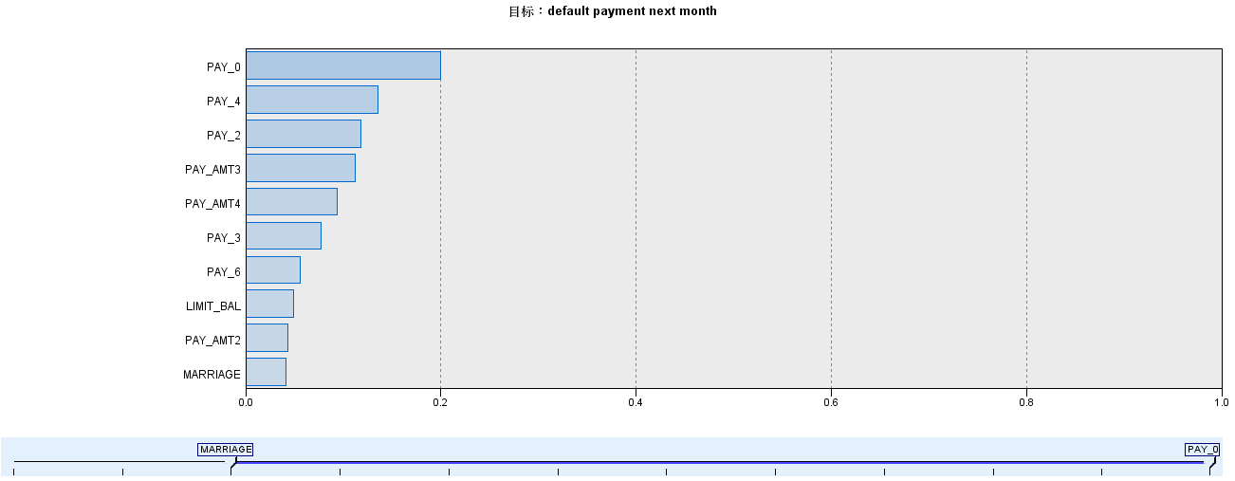
4. Decision Tree
Tool: IBM SPSS/ SAS EM
Method: C5.0, C&R T, CHAID
Feature importance

Slide 13
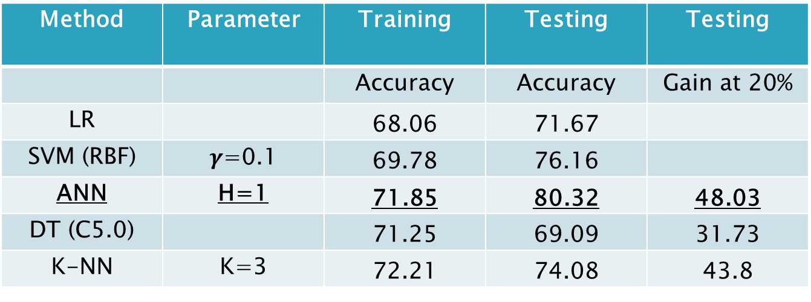
Comparison of Different Methods
Method | Parameter | Training | Testing | Testing
 |  | Accuracy | Accuracy | Gain at 20%
LR |  | 68.06 | 71.67
SVM (RBF) | $γ$=0.1 | 69.78 | 76.16
ANN | H=1 | 71.85 | 80.32 | 48.03
DT (C5.0) |  | 71.25 | 69.09 | 31.73
K-NN | K=3 | 72.21 | 74.08 | 43.8
K-NN: K- Nearest Neighbors Algorithm

Slide 14
Some Conclusions
Artificial Neural Network has the best testing accuracy with 80.32%
Default has little to do with Gender
Single people are more likely to default
Higher educated people are more likely to default
People with default behavior have a greater age average
People with default history are more likely to default in the future

Slide 15
Future Work
SVM polynomial kernel with D>4
Random Tree
Bayes Network

Slide 16
Reference
[2009]The comparisons of data mining techniques for the predictive accuracy of probability of default of credit card clients, I-Cheng Yeh a,*, Che-hui Lien b
Data Mining: Concepts and Techniques - 3rd edition

Slide 17
Thank you!

